Slide 1
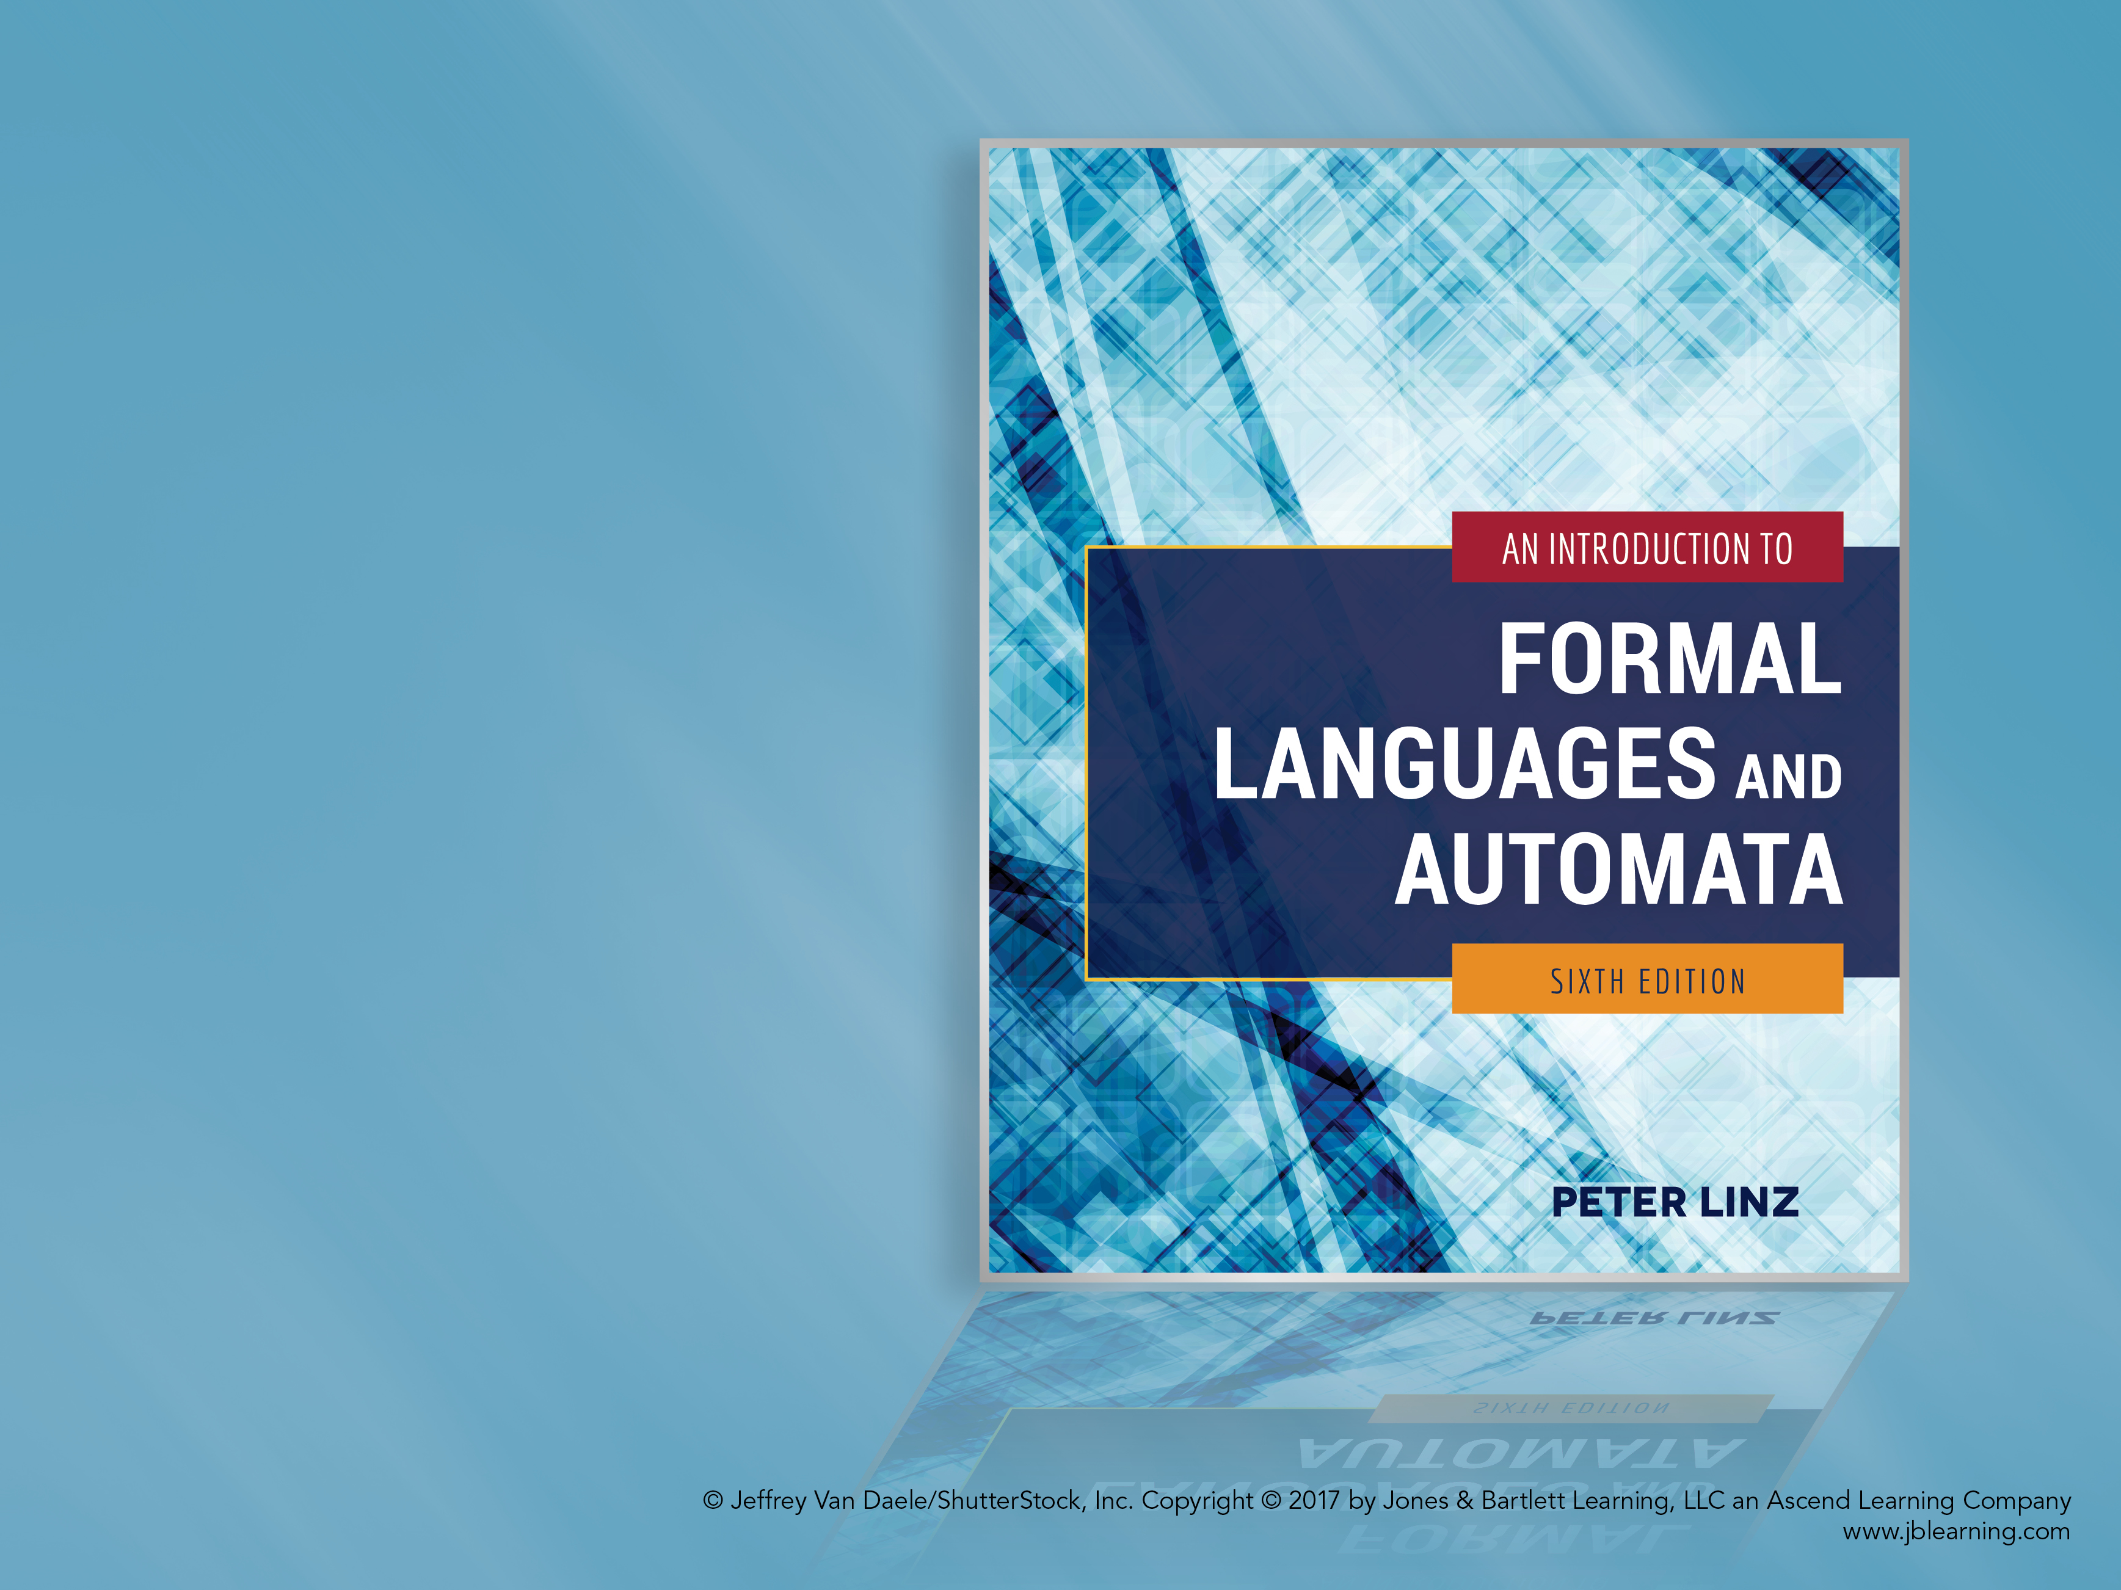
Chapter 7
PUSHDOWN AUTOMATA

Slide 2
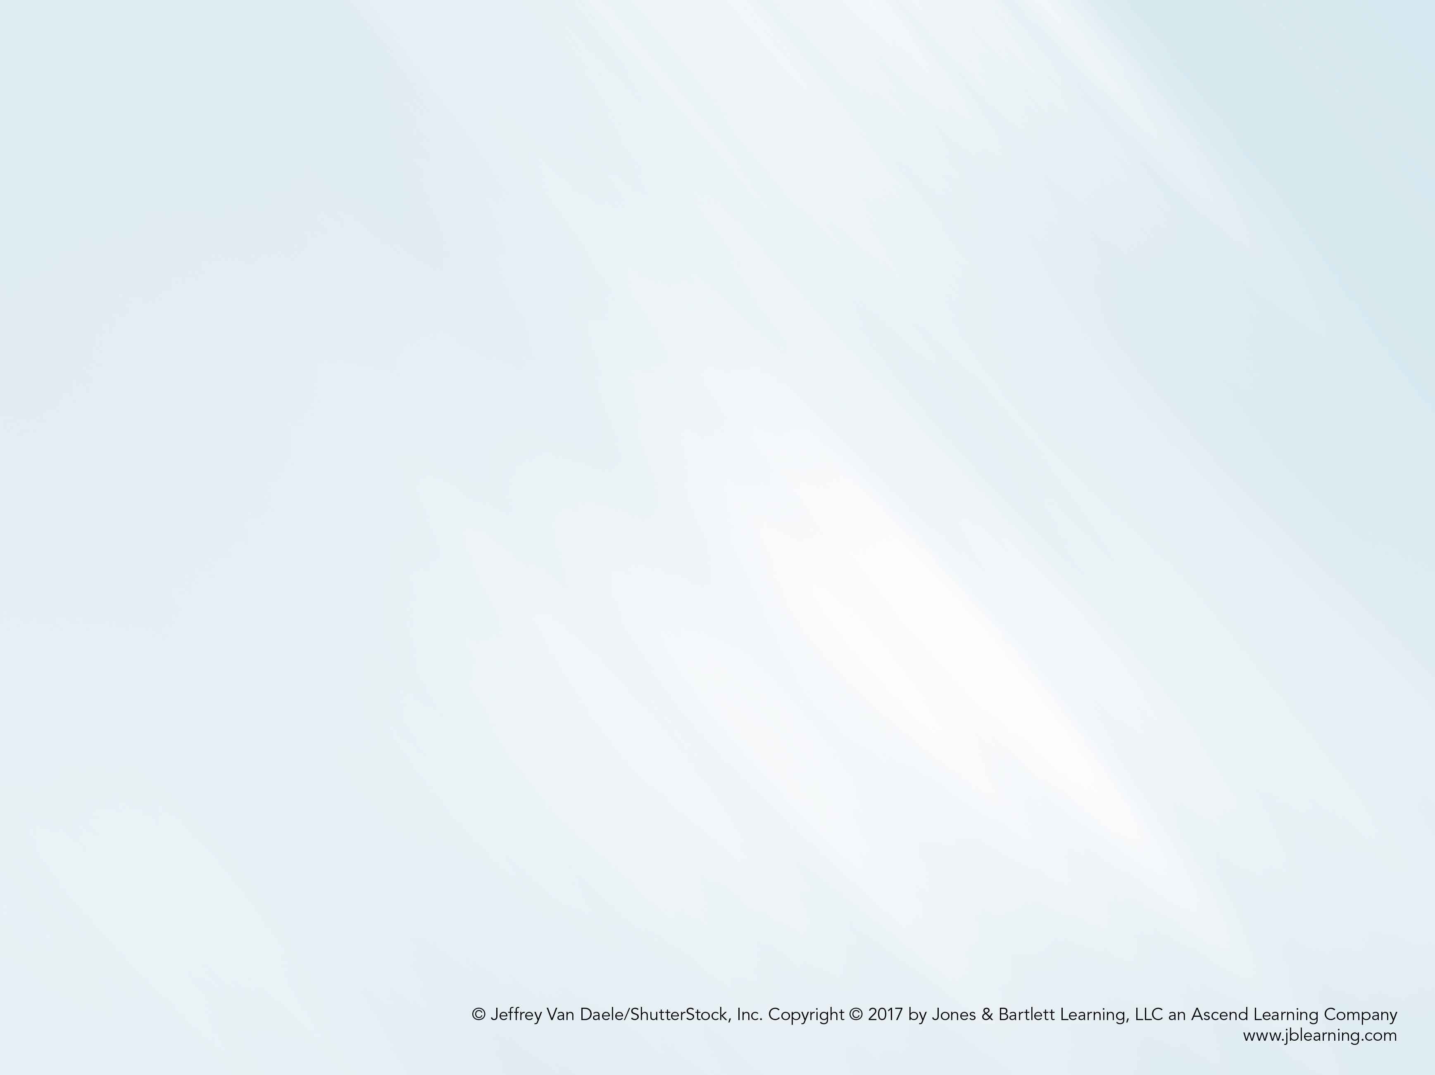
Learning Objectives At the conclusion of the chapter, the student will be able to:
Describe the components of a nondeterministic pushdown automaton
State whether an input string is accepted by a nondeterministic pushdown automaton
Construct a pushdown automaton to accept a specific language
Given a context-free grammar in Greibach normal form, construct the corresponding pushdown automaton
Describe the differences between deterministic and nondeterministic pushdown automata
Describe the differences between deterministic and general context-free languages

Slide 3
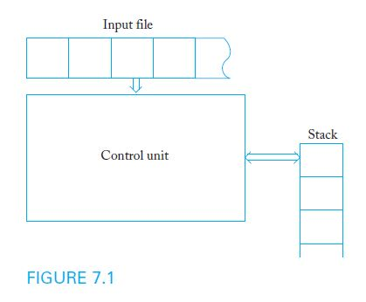
Nondeterministic Pushdown Automata
A pushdown automaton is a model of computation designed to process context-free languages
Pushdown automata use a stack as storage mechanism

Slide 4
Nondeterministic Pushdown Automata
A nondeterministic pushdown accepter (npda) is defined by:
A finite set of states Q
An input alphabet Σ
A stack alphabet Γ
A transition function δ
An initial state q₀
A stack start symbol z
A set of final states F
Input to the transition function δ consists of a triple consisting of a state, input symbol (or λ), and the symbol at the top of stack
Output of δ consists of a new state and new top of stack
Transitions can be used to model common stack operations

Slide 5
Sample npda Transitions
Example 7.1 presents the sample transition rule:
δ(q₁, a, b) = {(q₂, cd), (q₃, λ)}
According to this rule, when the control unit is in state q₁, the input symbol is a, and the top of the stack is b, two moves are possible:
New state is q₂ and the symbols cd replace b on the stack
New state is q₃ and b is simply removed from the stack
If a particular transition is not defined, the corresponding (state, symbol, stack top) configuration represents a dead state

Slide 6
A Sample Nondeterministic Pushdown Accepter
Example 7.2: Consider the npda
Q = { q₀, q₁, q_{2,} q₃ }, Σ = { a, b }, Γ= { 0, 1 }, z = 0, F = {q₃}
with initial state q₀ and transition function given by:
δ(q₀, a, 0) = { (q_{1,} 10), (q₃, λ) }
δ(q₀, λ, 0) = { (q₃, λ) }
δ(q₁, a, 1) = { (q_{1,} 11) }
δ(q₁, b, 1) = { (q_{2,} λ) }
δ(q₂, b, 1) = { (q_{2,} λ) }
δ(q₂, λ, 0) = { (q₃, λ) }
As long as the control unit is in q₁, a 1 is pushed onto the stack when an a is read
The first b causes control to shift to q₂, which removes a symbol from the stack whenever a b is read

Slide 7
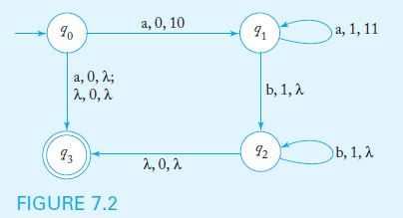
Transition Graphs
In the transition graph for a npda, each edge is labeled with the input symbol, the stack top, and the string that replaces the top of the stack
The graph below represents the npda in Example 7.2:

Slide 8
Instantaneous Descriptions
To trace the operation of a npda, we must keep track of the current state of the control unit, the stack contents, and the unread part of the input string
An instantaneous description is a triplet (q, w, u) that describes state, unread input symbols, and stack contents (with the top as the leftmost symbol)
A move is denoted by the symbol ˫
A partial trace of the npda in Example 7.2 with input string ab is
(q₀, ab, 0) ˫ (q₁, b, 10) ˫ (q₂, λ, 0) ˫ (q₃, λ, λ)

Slide 9
The Language Accepted by a Pushdown Automaton
The language accepted by a npda is the set of all strings that cause the npda to halt in a final state, after starting in q₀ with an empty stack.
The final contents of the stack are irrelevant
As was the case with nondeterministic automata, the string is accepted if any of the computations cause the npda to halt in a final state
The npda in example 7.2 accepts the language
{a^{n}b^{n}: n ≥ 0} ∪ { a }

Slide 10
Pushdown Automata and Context-Free Languages
Theorem 7.1 states that, for any context-free language L, there is a npda to recognize L
Assuming that the language is generated by a context-free grammar in Greibach normal form, the constructive proof provides an algorithm that can be used to build the corresponding npda
The resulting npda simulates grammar derivations by keeping variables on the stack while making sure that the input symbol matches the terminal on the right side of the production

Slide 11
Construction of a Npda from a Grammar in Greibach Normal Form
The npda has Q = { q₀, q₁, q_{F} }, input alphabet equal to the grammar terminal symbols, and stack alphabet equal to the grammar variables
The transition function contains the following:
A rule that pushes S on the stack and switches control to q₁ without consuming input
For every production of the form A → aX, a rule
δ (q₁, a, A) = (q₁, X)
A rule that switches the control unit to the final state when there is no more input and the stack is empty

Slide 12
Sample Construction of a NPDA from a Grammar
Example 7.6 presents the grammar below, in Greibach normal form
S → aSA | a
A → bB
B → b
The corresponding npda has Q = { q₀, q₁, q₂ } with initial state q₀ and final state q₂
The start symbol S is placed on the stack with the transition
δ(q₀, λ, z) = { (q₁, Sz) }
The grammar productions are simulated with the transitions
δ(q₁, a, S) = { (q_{1,} SA), (q_{1,} λ) }
δ(q₁, b, A) = { (q_{1,} B) }
δ(q₁, b, B) = { (q_{1,} λ) }
A final transition places the control unit in its final state when the stack is empty
δ(q₁, λ, z) = { (q₂, λ) }

Slide 13
Deterministic Pushdown Automata
A deterministic pushdown accepter (dpda) never has a choice in its move
Restrictions on dpda transitions:
Any (state, symbol, stack top) configuration may have at most one (state, stack top) transition definition
If the dpda defines a transition for a particular (state, λ, stack top) configuration, there can be no input-consuming transitions out of state s with a at the top of the stack
Unlike the case for finite automata, a λ-transition does not necessarily mean the automaton is nondeterministic

Slide 14
Example of a Deterministic Pushdown Automaton
Example 7.10 presents a dpda to accept the language
L = { a^{n}b^{n}: n ≥ 0 }
The dpda has Q = { q₀, q₁, q₂ }, input alphabet { a, b }, stack alphabet { 0, 1 }, z = 0, and q₀ as its initial and final state
The transition rules are
δ(q₀, a, 0) = { (q₁, 10) }
δ(q₁, a, 1) = { (q_{1,} 11) }
δ(q₁, b, 1) = { (q_{2,} λ) }
δ(q₂, b, 1) = { (q_{2,} λ) }
δ(q₂, λ, 0) = { (q_{0,} λ) }

Slide 15
Deterministic Context-Free Languages
A context-free language L is deterministic if there is a dpda to accept L
Sample deterministic context-free languages:
{ a^{n}b^{n}: n ≥ 0 }
{ wxw^{R}: w ∈ {a, b}*}
Deterministic and nondeterministic pushdown automata are not equivalent: there are some context-free languages for which no dpda can be built

